Slide 1
Hospital Data
April 2016
Harrison Wallace
Rahul Gupta
Gopi Jeeredy
Viren Abelak
Notes:
Template version: 11/20/2012, for PowerPoint 2007 & 2010

Slide 2

We are trying to build a model that best predicts probability of heart disease
We have access to data from 4 hospitals and about ~1000 patients with 13 key features
Age ?
Sex ?
Chest Pain?
Resting Blood Pressure?
Cholesterol?
Fasting Blood Sugar?
Resting ECG?
Max Heart Rate?
Exercise Angina?
ST Exercise Induced?
Slope?
Number Vessels?
Thal?

Slide 3
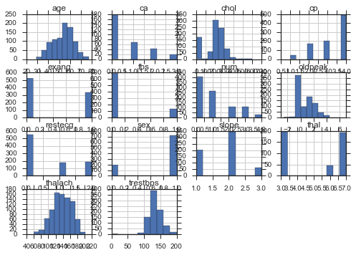
We examined the data for each feature and dropped those that did not have enough data
Additional data cleaning
Heart disease (target) simplified to 0 and 1 (one of the hospitals had 0-4)
Make cholesterol =0 to be NaN
Drop all rows that are NaN
Scaled data using sklearn.tranform

Slide 4
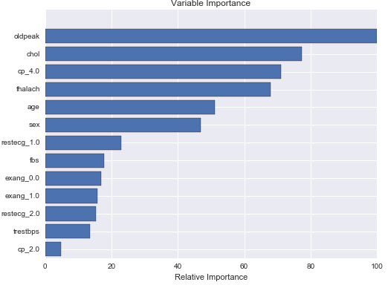
We used Gradient Boosted Ensemble to get a first high level pass of significant variables

Slide 5
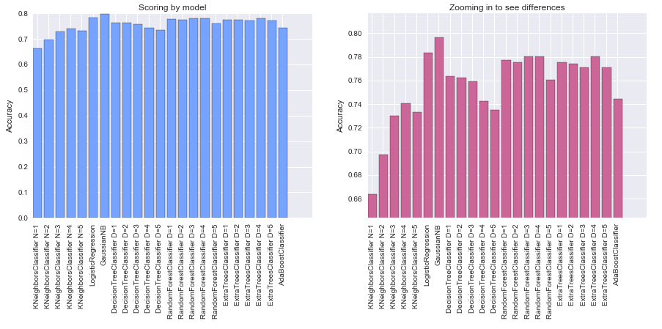
Compared a simplified feature set against multiple models
Scoring: Accuracy
LogisticRegression and GaussianNB score highest

Slide 6
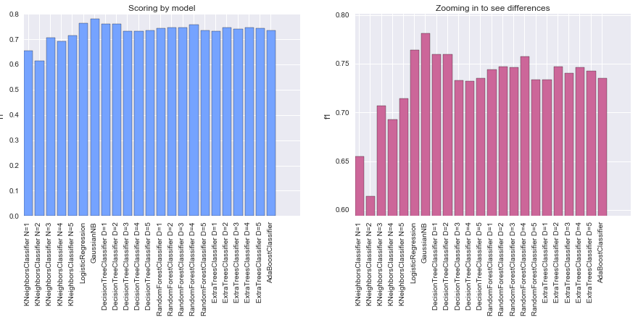
Compared a simplified feature set against multiple models
Scoring: f1
LogisticRegression and GaussianNB score highest

Slide 7
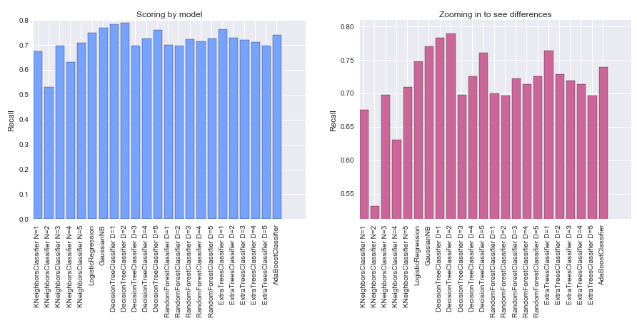
Compared a simplified feature set against multiple models
Scoring: Recall
Decision Tree(depth=2), Gaussian and ExtraTree(depth=1) are highest

Slide 8
We decided to go with Logistic Regression due to high scores (by default) and easier to explain
Various combinations of variables in the model and interaction effects were tested
We hypothesized that age might have some strong interactions with the other variables, just based on intuition
After testing, this was only seen to be the case with Age: Cholesterol, but the effect was not found to be strong enough for Cholesterol to stay in the model

Slide 9
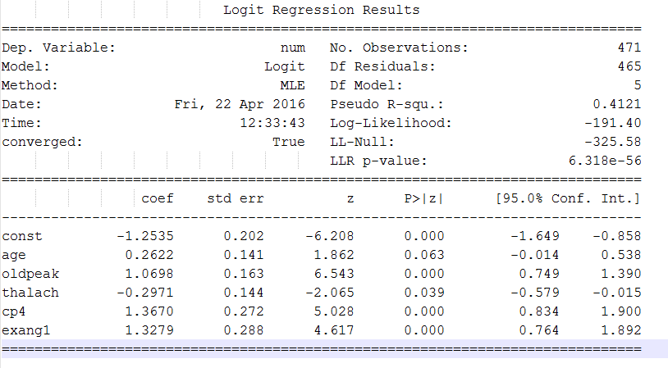
Logistic Regression Stats Models Summary
oldpeak – ECG reading from exercise relative to rest
thalach – Maximum heart rate achieved
cp4 – Factor variable indicating asymptomatic chest pain
exang – Exercise induced chest pain

Slide 10
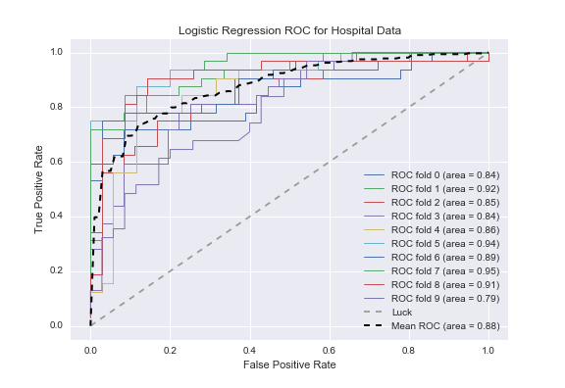
ROC Curve

Slide 11
Through 10 fold cross validation, found that a probability threshold of .2 is best for maximizing recall while retaining a high fscore
threshold = 0.05 precision, recall, fscore = (0.490217443829635, 0.99687499999999996, 0.65569305888206231)
threshold = 0.1 precision, recall, fscore = (0.54778815087559063, 0.98124999999999996, 0.69805885466469897)
threshold = 0.15 precision, recall, fscore = (0.62319501879586814, 0.953125, 0.74869713290599615)
threshold = 0.2 precision, recall, fscore = (0.65358508973984186, 0.921875, 0.76001837688477869)
threshold = 0.25 precision, recall, fscore = (0.68208510692206348, 0.89687499999999998, 0.76783359950416918)
threshold = 0.3 precision, recall, fscore = (0.71142549861243143, 0.87187499999999996, 0.77566000794498169)
threshold = 0.35 precision, recall, fscore = (0.7408386397467509, 0.84989919354838717, 0.78039782614236908)
threshold = 0.4 precision, recall, fscore = (0.75991379611174081, 0.80594758064516125, 0.77230679947592784)
threshold = 0.45 precision, recall, fscore = (0.78512513951643081, 0.77449596774193552, 0.77070435581124996)
threshold = 0.5 precision, recall, fscore = (0.81036441956595451, 0.7494959677419355, 0.7699732485451104)

Slide 12
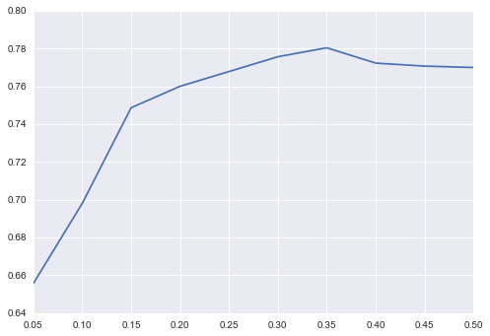
Probability threshold of 0.2 is best for maximizing recall
Recall at various values of probability threshold
f1
Probability Threshold

Slide 13
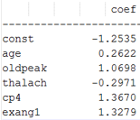
What we learned
Variable | Description of variable | Insight
age | Age of patient | Probability of heart disease increases with age (dah!)
oldpeak | Stress Test ECG results (in mm) | Larger peak indicates heart disease
thalach | Max heart rate achieved | The lower you max heart rate, the higher probability of disease
cp4 | Chest pain (at level 4) | If you have pain (strong), you are at risk
exang | Chest pain induced by exercise | Increase probability of disease

